Slide 1
Distillation Column Design
Department of Chemical Engineering Indian Institute of Technology, Kanpur
DISTILLATION COLUMN DESIGN PROJECT -By
HARJAP SINGH
ADITYA SINGH KAURAV

Slide 2
DISTILLATION
Department of Chemical Engineering Indian Institute of Technology, Kanpur
DISTILLATION
Distillation refers to the selective boiling and subsequent condensation of a component in a liquid mixture. The process of distillation exploits the difference in the boiling points of the components in the liquid mixture by forcing one of them into a gaseous state.
It is an energy intensive process but high purity can be obtained by it
Applications in Industry
A wide range of Petroleum Products can be obtained like:
Gasoline , Diesel fuel , Lubricating oil , Fuel oil , paraffin wax , petrochemicals

Slide 3

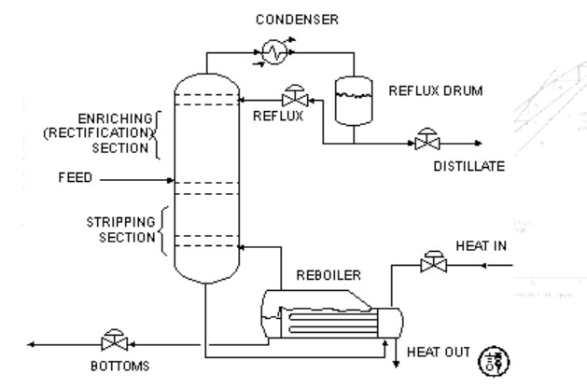

BINARY DISTILLATION COLUMN
Department of Chemical Engineering Indian Institute of Technology, Kanpur
The main components are –
a vertical shell where the separation of liquid components is carried
column internals such as trays/plates and/or packings which are used to enhance component separations
▪
▪
a reboiler to provide the necessary vaporization for the distillation
a condenser to cool and condense the vapor leaving the top of the
column
a reflux drum to hold the condensed vapor from the top of the column so that liquid (reflux) can be recycled back to the column
The liquid mixture that is to be processed is known as the feed and this is introduced usually somewhere near the middle of the column to a tray known as the feed tray. The feed tray divides the column into a top (enriching or rectification) section and a bottom (stripping) section.
The liquid removed from the reboiler is known as the bottoms product or simply, bottoms.
The condensed liquid that is removed from the system is known as the distillate or top product.

Slide 4
SYSTEM CHOSEN – (ACETONE & CHOLOFORM)
Department of Chemical Engineering Indian Institute of Technology, Kanpur
The system chosen is Acetone-Chloroform because it is non-ideal and Azeotropic.
System shows the positive deviation from Rault’s law and form maximum Boiling Point Azeotrope.
There is a small difference in the boiling point of both compounds (Acetone – 56 deg Celsius and Chloroform – 61 deg Celsius).
The acetone is the light key component as it is more volatile and chloroform is heavy key component
Techniques like Extraction Distillation and Pressure Distillation are used in later stages during this project to separate acetone from chloroform.

Slide 5
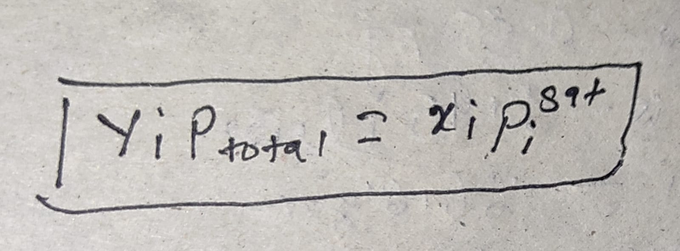
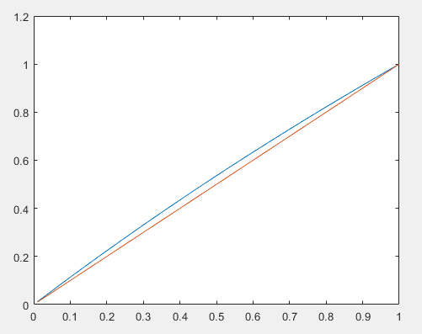
VAPOUR LIQUID EQUILIBRIUM OF ACETONE-CHLOROFORM
Department of Chemical Engineering Indian Institute of Technology, Kanpur
First we have plotted xy equilibrium curve for this mixture assuming it as ideal solution. Antoine's equation is used for calculating the saturation pressure for both the components. Here we done all this at 337.7 k.
We have used Rault's law here as given by this equation.
X is taken to be from 0 to 1.

Slide 6
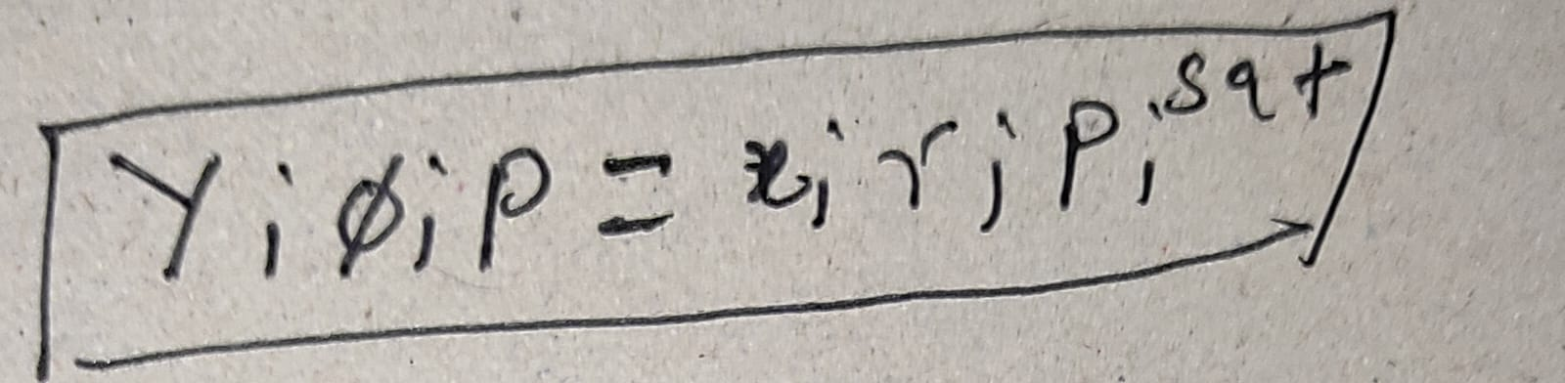
VAPOUR LIQUID EQUILIBRIUM OF ACETONE-CHLOROFORM
Department of Chemical Engineering Indian Institute of Technology, Kanpur
After plotting graph for ideal solution we have plotted for non-ideal solution of Acetone chloroform. Antoine's equation is used for calculating saturation pressures of both components. Wilson model is used for calculating activity coefficients and Vander waal's equation is used for calculating fugacity coefficients.
Whole work is done at 337.7 k.
X is taken to be from 0 to 1.
For each point activity coefficient is calculated and applied in equation as written above y(mole fraction in vapor phase) . And Gibb's phase rule is used same as in previous case.

Slide 7
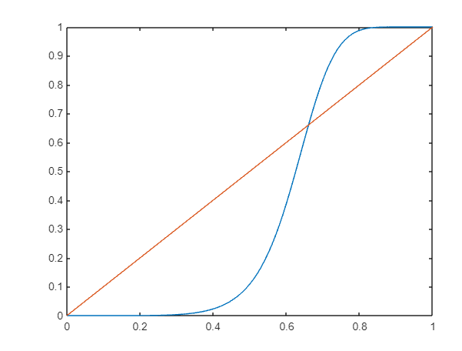
Continue....
Non- Ideal:
XY diagram for acetone – chloroform non-ideal Solution

Slide 8

MCCABE THIELE PROCESS SIMULATION
Department of Chemical Engineering Indian Institute of Technology, Kanpur
The values of feed composition (xf), distillate composition (xd) , bottoms composition (x_bottom) and (q) value of the feed were taken from the user. All these are the compositions for acetone (more volatile component)
Then , draw the q line using the equation
To get the reflux ratio , we found the minimum reflux ratio first. Reflux ratio is minimum when top section line intersects the equilibrium curve
We found the intersection of q line with equilibrium curve and passed a line from that intersection
point and (xd , xd). The y intercept of line is xd/(Rmin+1)
By getting R min we got reflux ratio as R=1.3* Rmin

Slide 9

MCCABE THIELE PROCESS SIMULATION
Department of Chemical Engineering Indian Institute of Technology, Kanpur
After getting Reflux ratio , plot the top section line using the equation
Then find the intersection point of the top line and the q-line and name it as
(x_intersect , y_intersect)
After that to calculate the top section stages , run a for loop till x coordinate is greater than the x_intersect as at x_intersect , the feed tray will be inserted . Keep on drawing horizontal lines and look for intersection point with curve and then drop a vertical line and so on. This gives us the number of trays required for top section
Similarly to draw the bottom line use two points (xv , xv) and (x_intersect , y_intersect) and find the
number of stages for bottom section as well
Actual Number of Stages = Top Section Stages + Bottom Section Stages

Slide 10
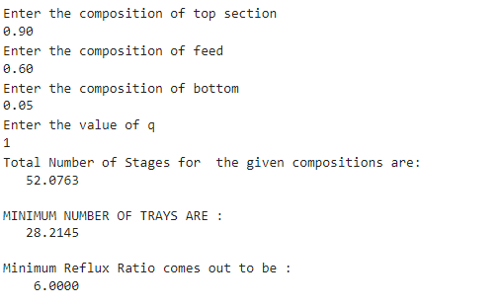
Distillation Column Design
Department of Chemical Engineering Indian Institute of Technology, Kanpur
ACTUAL NUMBER OF STAGES & MINIMUM NUMBER OF STAGES
Minimum stages are calculated by intersecting the horizontal and vertical lines with y=x line as at minimum
stages Reflux ratio is infinite so operating lines coincide with the y=x line.
Simulations has been performed on the basis of following values ,taken from user:

Slide 11
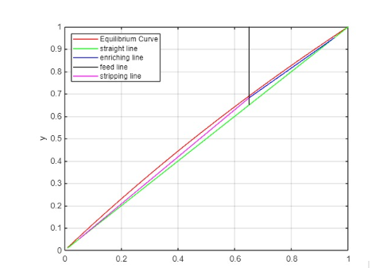
Plots and Diagrams

Slide 12
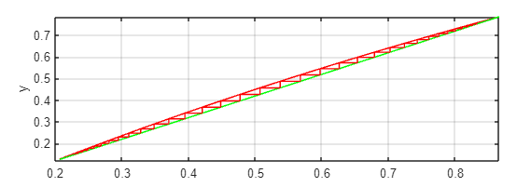
Plots and Diagrams
Maximum Number of Trays :

Slide 13
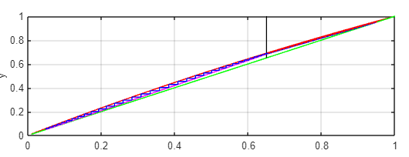
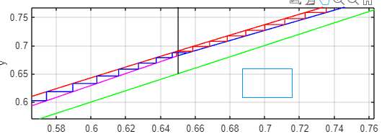
Plots and Diagrams
Tray Diagram Zoomed IN

Slide 14
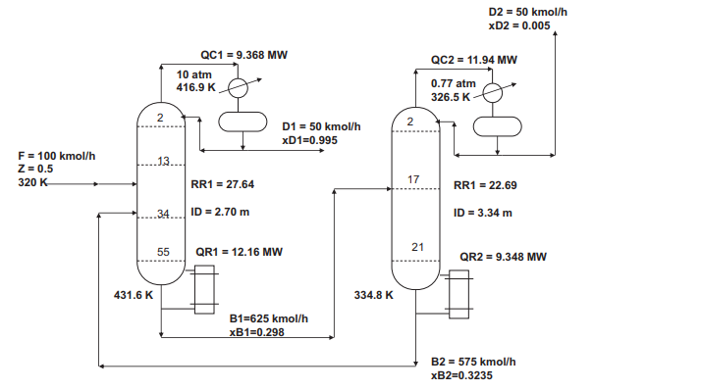
Pressure Swing distillation by DWSIM
Department of Chemical Engineering Indian Institute of Technology, Kanpur
For pressure swing I have followed in DWSIM as according to this chart:

Slide 15
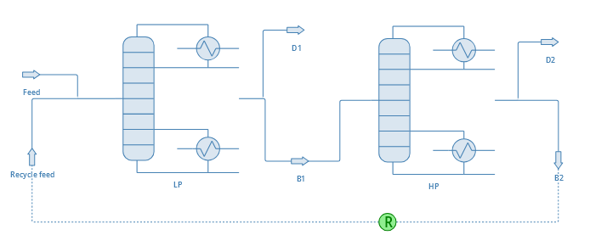
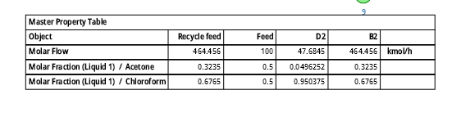
Pressure swing distillation
to separate acetone and chloroform, here we have used pressure swing distillation where two distillation column is used first at low pressure and another at high pressure.
Results by DWSIM are as follows:-
Continue...
Setup in DWSIM column looks like as:-

Slide 16
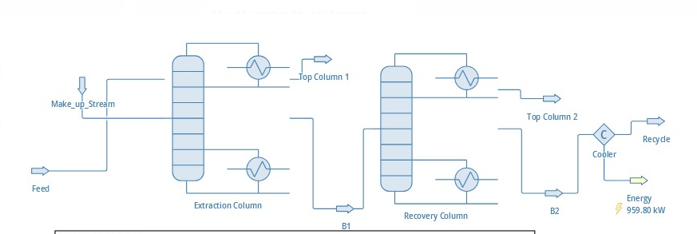
Extractive Distillation
Here , we use DMSO -Dimethyl Sulfoxide as entrainer.Acetone has boiling point near to 56°C and chloroform has about 61°C .So due to their low boiling point difference , extractive distillation become the foremost choice ,which is also seen in results:
Setup:-
Data taken as:-
Feed :
Molar Flow Rate :100 kmol/hr
Acetone :0.5
Chloroform:0.5
Make up stream:
Molar Flow Rate : 164.4kmol/hr
Chloroform : 0.0001
DMSO : 0.9999

Slide 17
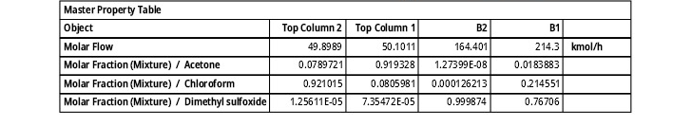
Extractive Distillation
Extractive Distillation Continued....
Bottom part of Extraction Column:
Molar Flow rate : 214.3 kmol/hr
Bottom part of Recovery Column
Molar Flow rate : 164.4 kmol/hr
Results obtained after taking considering the above data:
Conclusion:
Based on the above outputs generated in both cases , we can say that extraction distillation works better than pressure distillation in separating the acetone from chloroform .

Slide 18
WORK CONTRIBUTION OF GROUP MEMBERS
Department of Chemical Engineering Indian Institute of Technology, Kanpur
Aditya Singh Kaurav | Harjap Singh
Wrote matlab code for plotting xy plot for acetone chloroform system for both ideal and non ideal system. | Wrote matlab code for plotting xy plot for acetone chloroform system for both ideal and non ideal system.(we both were in campus at that time so both did both things).
Wrote the MATLAB code for getting the minimum number of stages. | Wrote the MATLAB code for getting the actual number of stages , Reflux ratio , Minimum Reflux Ratio.
Simulation in DWSIM for acetone-chloroform mixture separation by pressure swing distillation method. | Simulation in DWSIM for acetone-chloroform mixture separation by Extractive distillation method.

